Slide 1
Netsparker
Internship Studio’s Ethical Hacking Internship
Name: Jayanshu Dutta
The upcoming slides showcase the results from a security scan using Netsparker.

Slide 2
Vulnerability Report
Type: Cross-Site Scripting (XSS)
Website Analyzed: Zero Bank Web Application
URL: http://zero.webappsecurity.com/
Description:
The web application was found to be susceptible to Cross-Site Scripting through the inclusion of remote files. This kind of vulnerability can be exploited by attackers to inject malicious scripts into the website, potentially altering the user experience and behavior of the site.

Slide 3
Potential Impact
- Unauthorized script execution
- Website defacement
- Interception of sensitive data such as cookies and session tokens
- Deceptive pop-ups or misleading UI components

Slide 4
Recommended Solution
- Sanitize and validate all user inputs on the server side.
- Apply output encoding appropriate to the context (HTML, JavaScript, URL).
- Implement a Content Security Policy (CSP) to reduce script execution risks.
- Regularly scan and patch vulnerabilities to ensure continued protection.

Slide 5
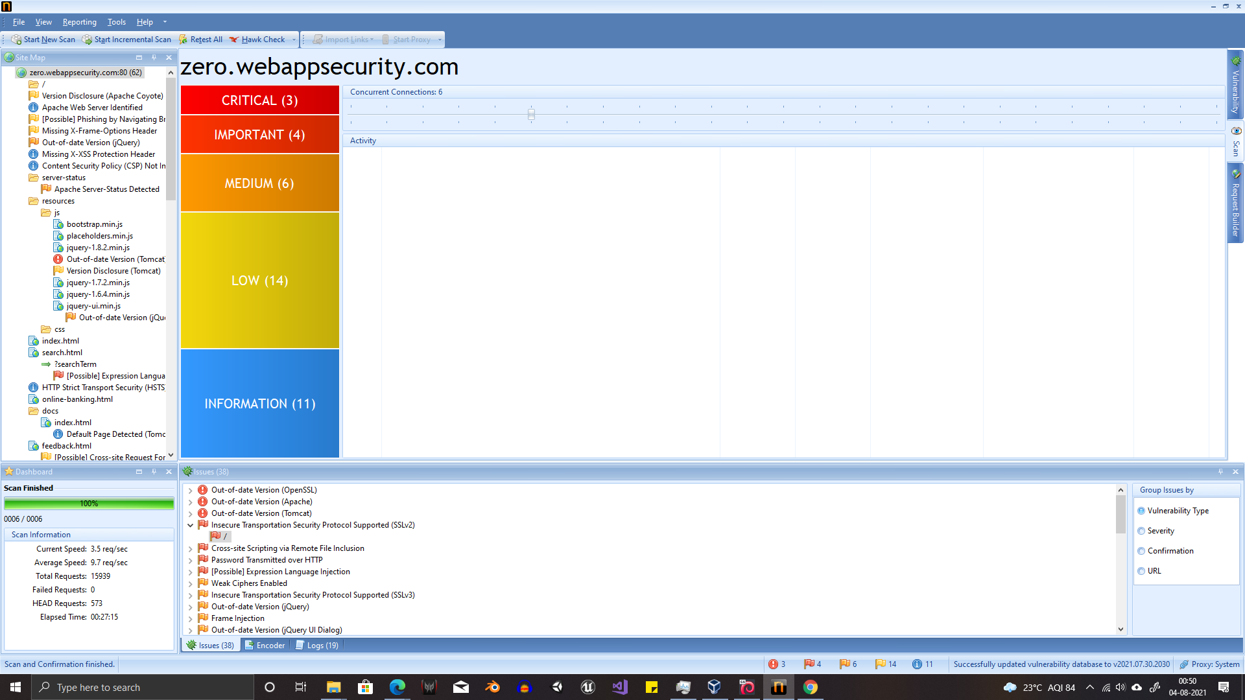

Slide 6
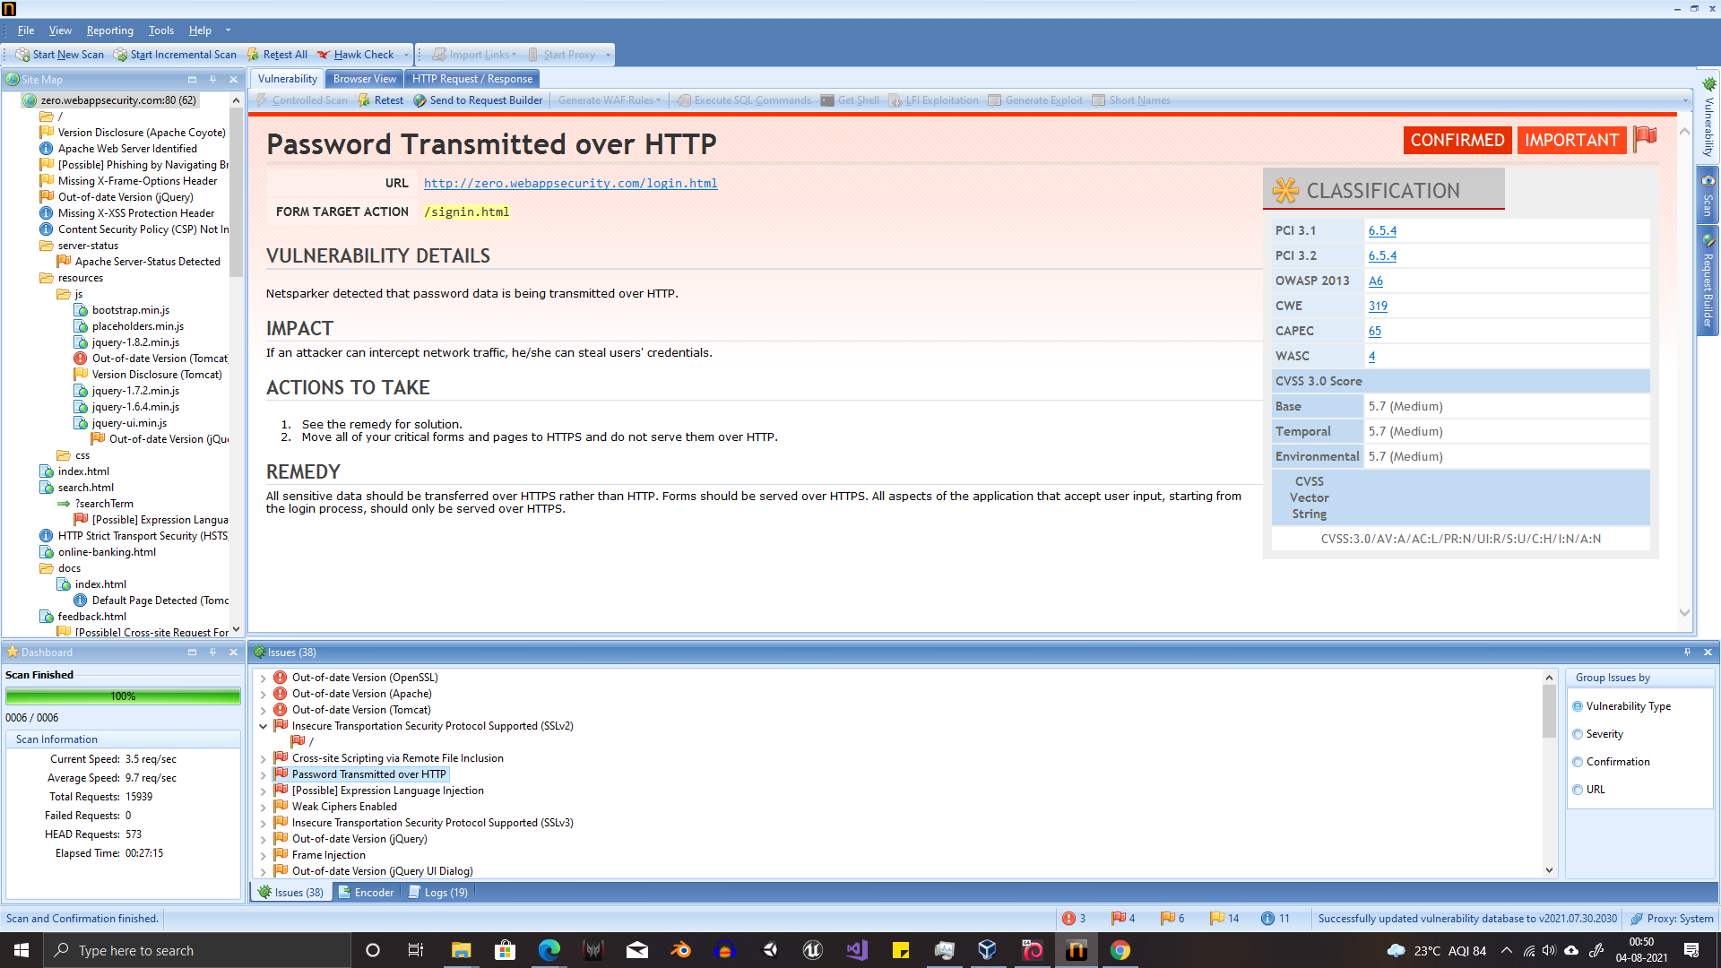

Slide 7
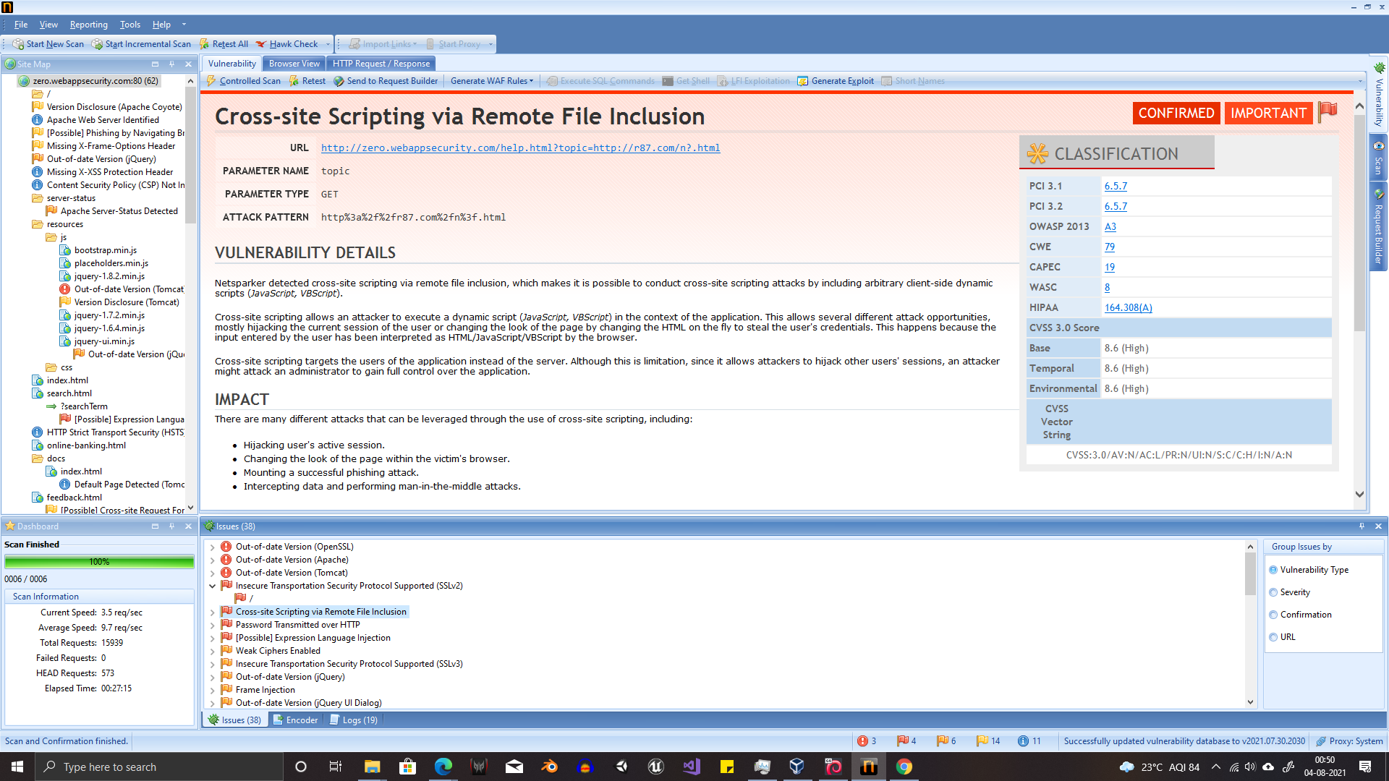

Slide 8
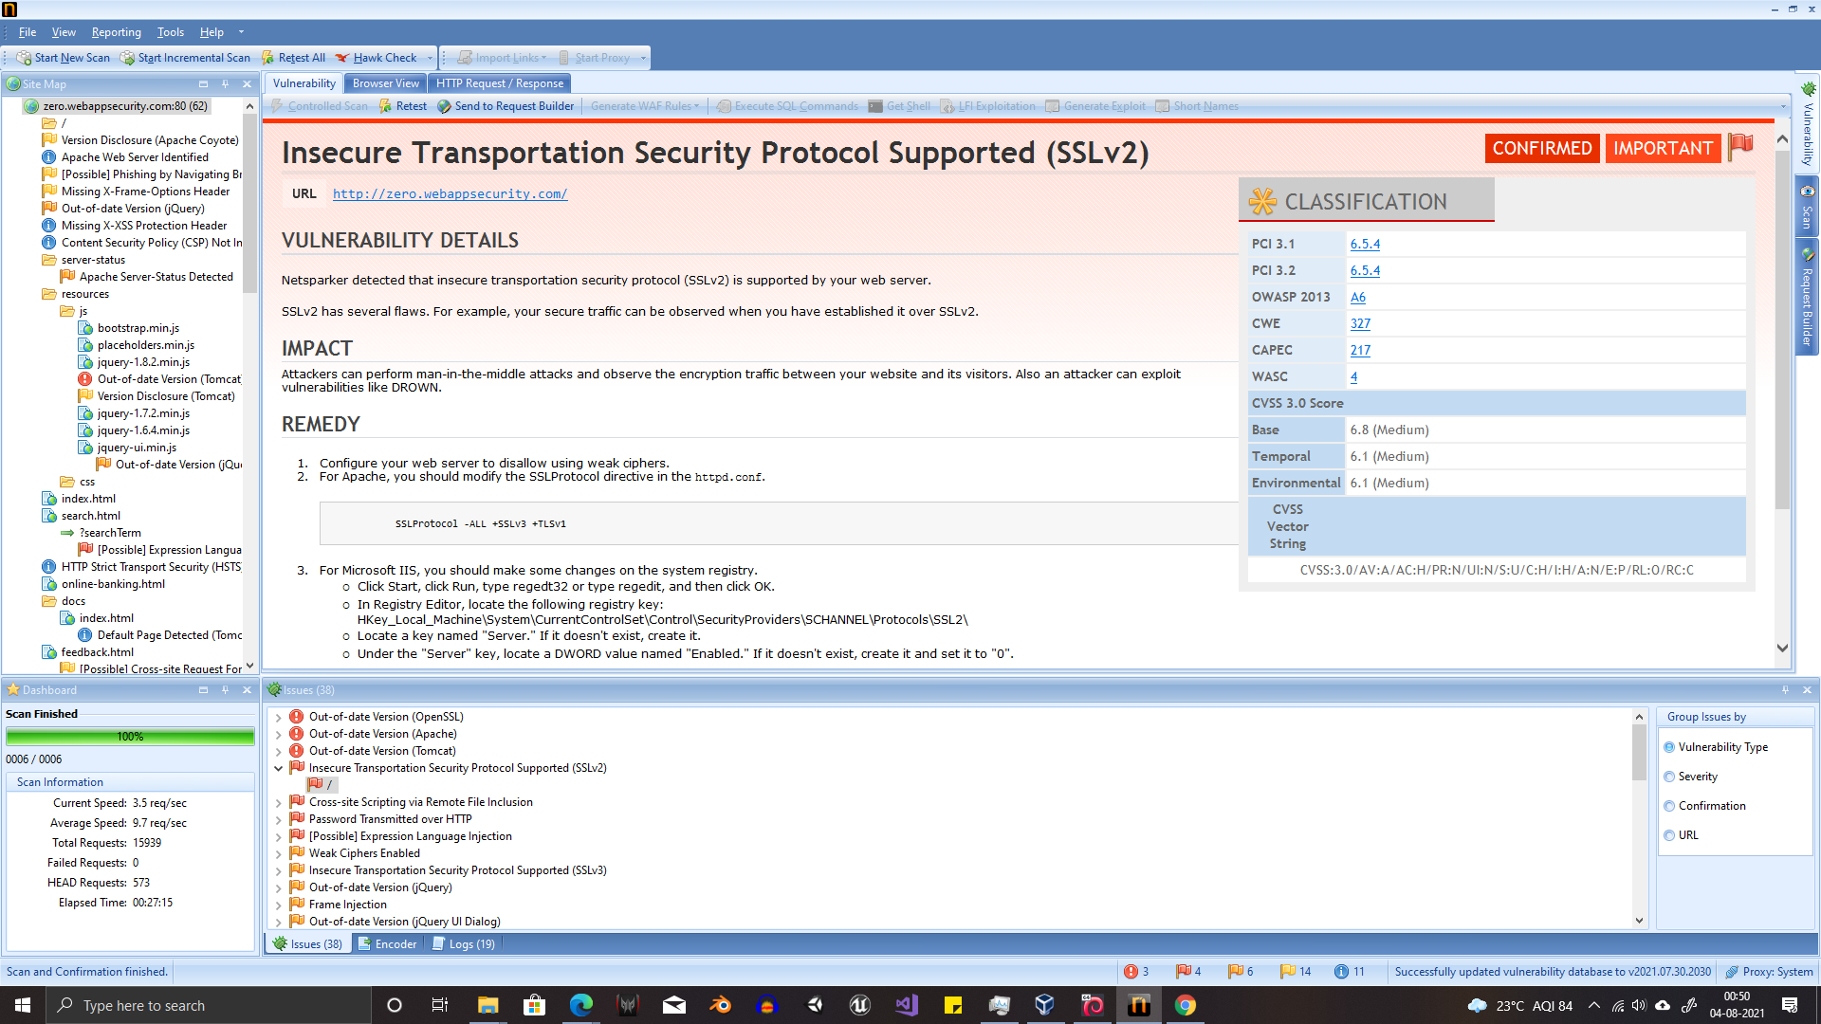

Slide 9
Thank
you

